Slide 1
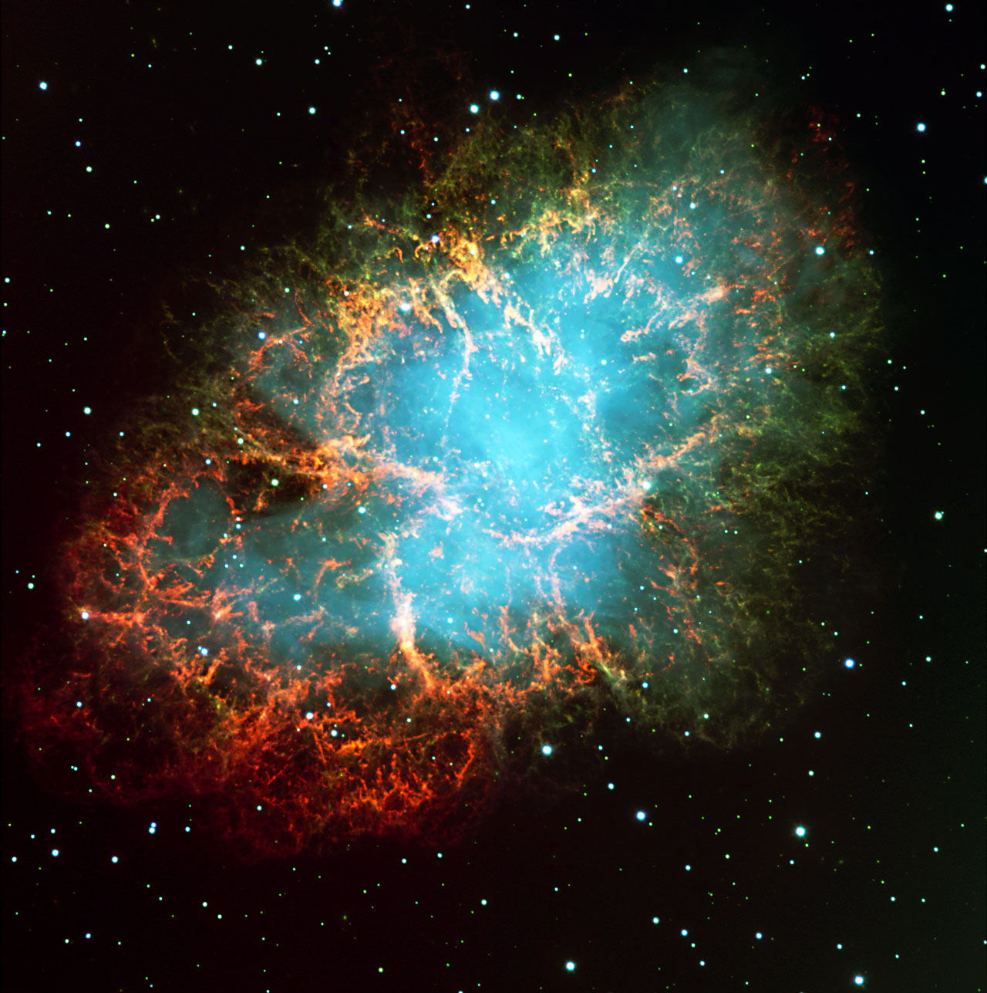
Type II Supernovae
The Explosive Death of Massive Stars
Yixuan Shao
PHY 599 Seminar II
Spring 2025

Slide 2
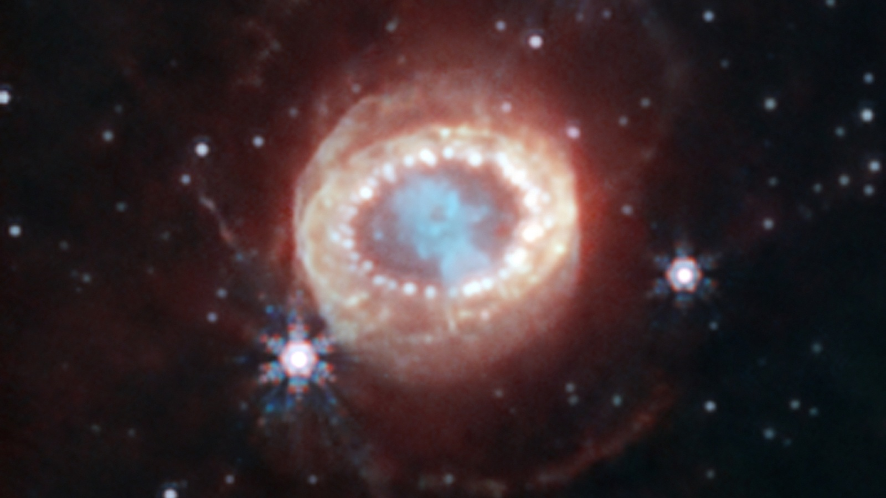
What is a Supernova?
SN 1987a as seen by JWST's Near-Infrared Camera. Credit: NASA, ESA, CSA, M. Matsuura, R. Arendt, C. Fransson

Slide 3

Supernova
A stellar explosion that occurs when a star reaches the end of its life, resulting in a rapid increase in brightness followed by the ejection of most of its mass into space.
Source: kenobi-wan-obi.tumblr.com

Slide 4
Supernova Classification Tree
Supernova
NO
First classification criteria
Hydrogen in its Spectrum
YES
Type I Supernova
Type II Supernova
Second classification criteria
Silicon
in its Spectrum
Light Curve
after Explosion
Second classification criteria
NO
Type Ia
Third classification criteria
Type II-P
YES
Lost Helium layer
Type Ib
Type Ic
Type II-L
Type IIn
narrow emission lines
White Dwarf in a Binary System
Shows a plateau
in light curve
NO
YES
Shows a linear decline in light curve
Thermonuclear
Core Collapse

Slide 5
Typically originates from massive stars with an initial mass ≥8 to ~40 M☉ (M☉ ≈ 2×10³³ kg).
Progenitor Mass
Spectrum Features
Hydrogen lines (Hα) are present in the optical spectrum, distinguishing Type II from Type I supernovae.
Light Curve
Plateau (II-P), Linear decline (II-L), or Narrow emission (IIn)
Brightness decline slower than Type I Supernova
Energy Released
~10⁵¹ ergs (kinetic), ~10⁵³ ergs (neutrinos)
Definition
Basic properties of Type II Supernova

Slide 6
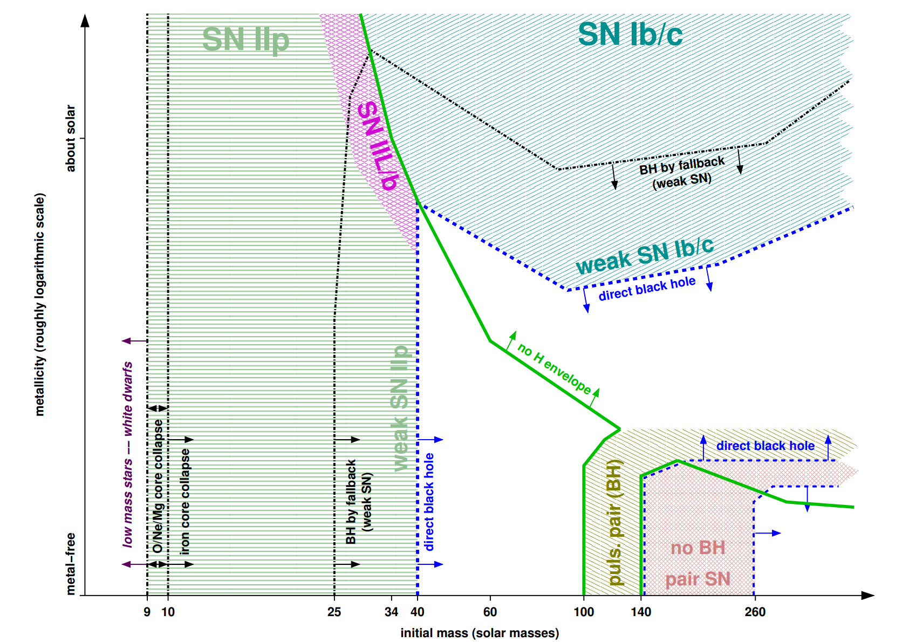
Progenitor Mass
Credit by Heger (2003) Fig. 2.
Supernovae Types of non-rotating massive single stars as a function of initial metallicity and initial mass.
Metallicity (roughly logarithmic scale)
Initial mass (solar masses)

Slide 7
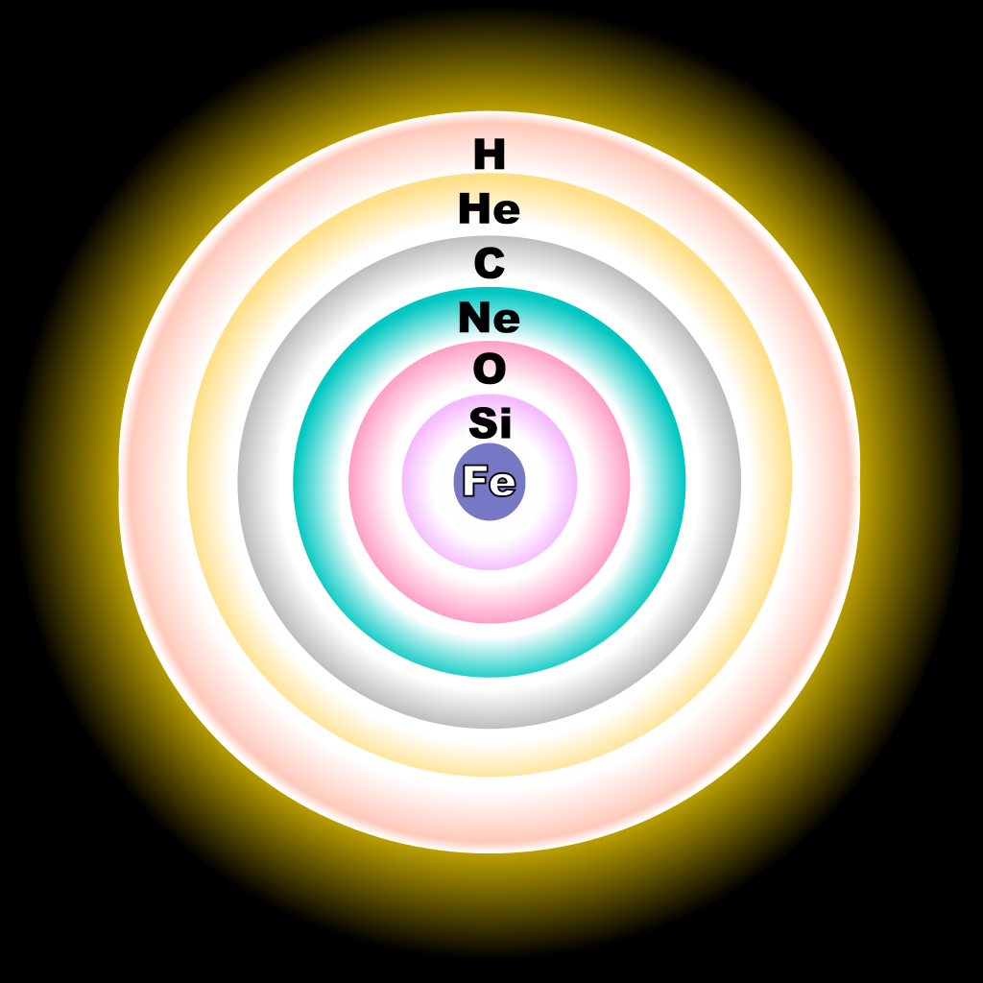
Formation
The onion-like layers of a massive, evolved star just before core collapse
This diagram shows a simplified (not to scale) cross-section of a massive, evolved star.
Where the pressure and temperature permit, concentric shells of Hydrogen (H), Helium (He), Carbon (C), Neon/Magnesium (Ne), Oxygen (O) and Silicon (Si) plasma are burning inside the star.
The resulting fusion by-products rain down upon the next lower layer, building up the shell below.
As a result of Silicon fusion, an inert core of Iron (Fe) plasma is steadily building up at the center.
Once this core reaches the Chandrasekhar mass, the iron can no longer sustain its own mass and it undergoes a collapse. This can result in a supernova explosion.
Evolved star fusion shells Credit by R. J. Hall

Slide 8
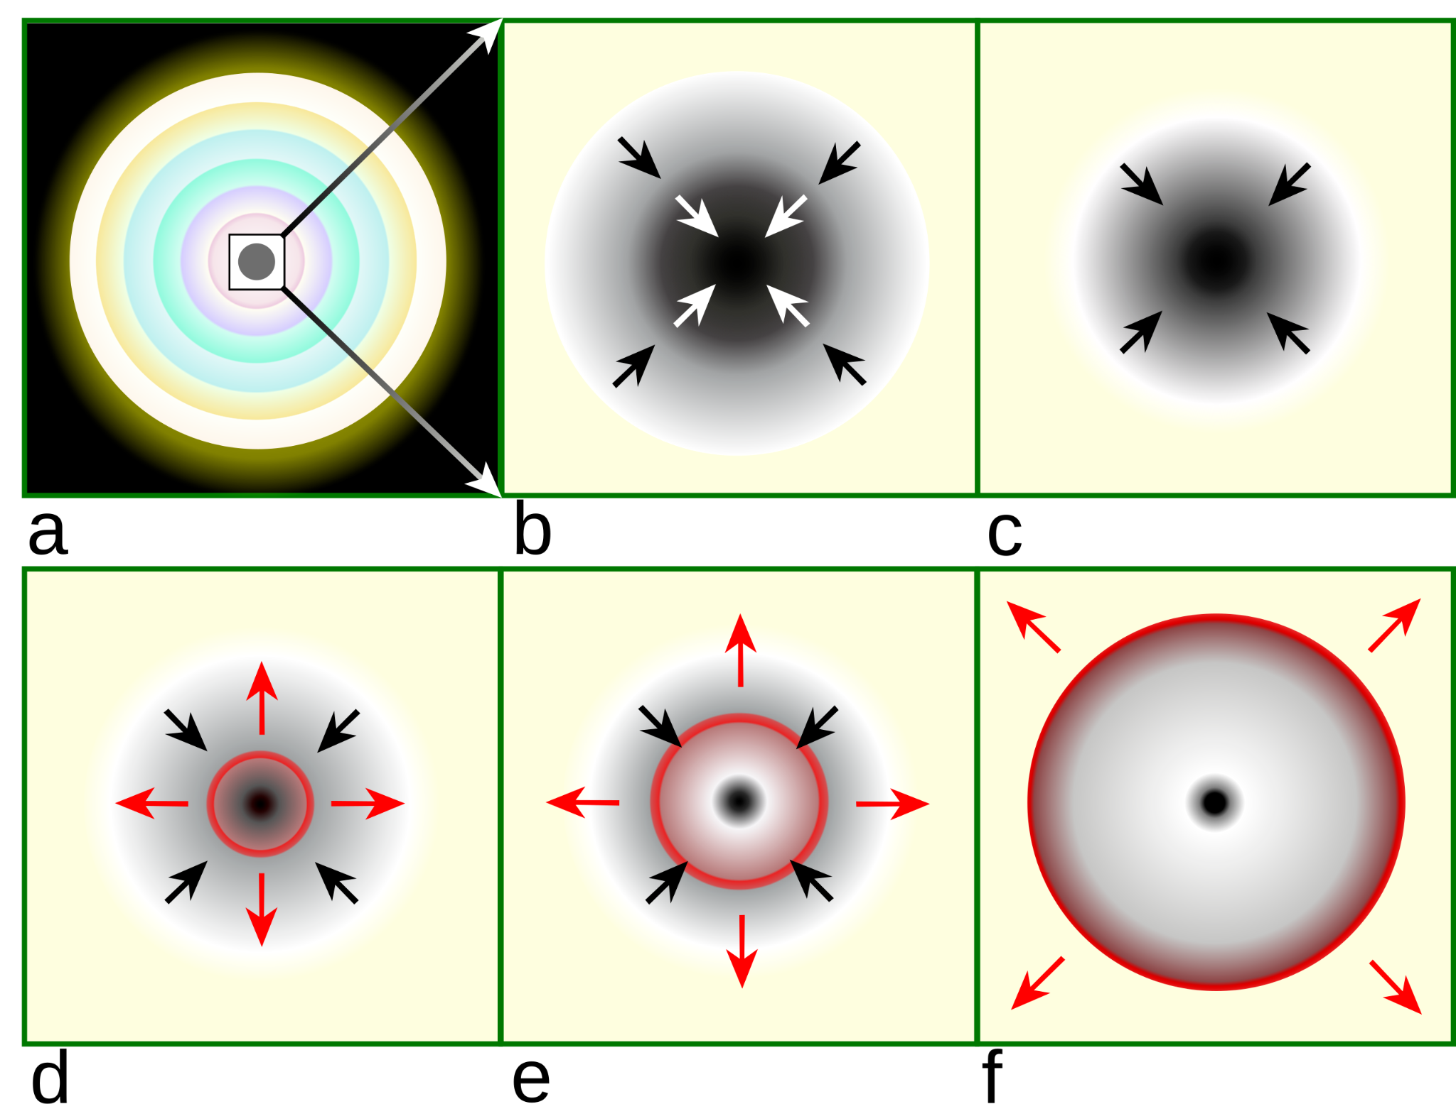
Core Collapse
(a) A massive, evolved star has onion-layered shells of elements undergoing fusion. An inert iron core is formed from the fusion of Silicon in the innermost shell.
(b) This iron core reaches Chandrasekhar-mass and starts to collapse.
(c) The inner core compresses into neutrons and the gravitational energy is converted into neutrinos.
(d) The infalling material bounces off the nucleus and forms an outward-propagating shock wave (red).
(e) The shock begins to stop as nuclear processes run energy away, but it is re-invigorated by interaction with neutrinos.
(f) The material outside the inner core is ejected, leaving behind only a degenerate remnant.
a
b
c
d
e
f
Core collapse scenario Credit by R. J. Hall

Slide 9
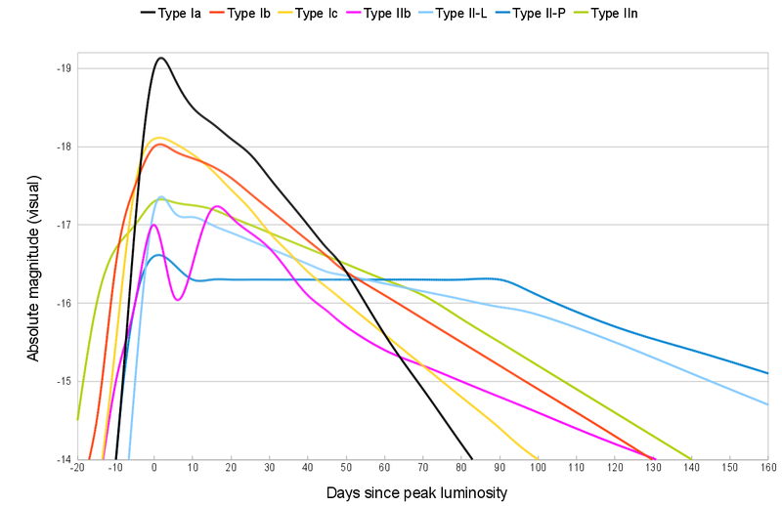
Light Curve of Supernova
Type II Supernovae are primarily distinguished by a much slower decline in luminosity when compared to the days after the event, highlighted by a prolonged plateau.
Type II Supernova
Absolute magnitude (visual)
Days since peak luminosity
Credit belongs to Lithopsian

Slide 10
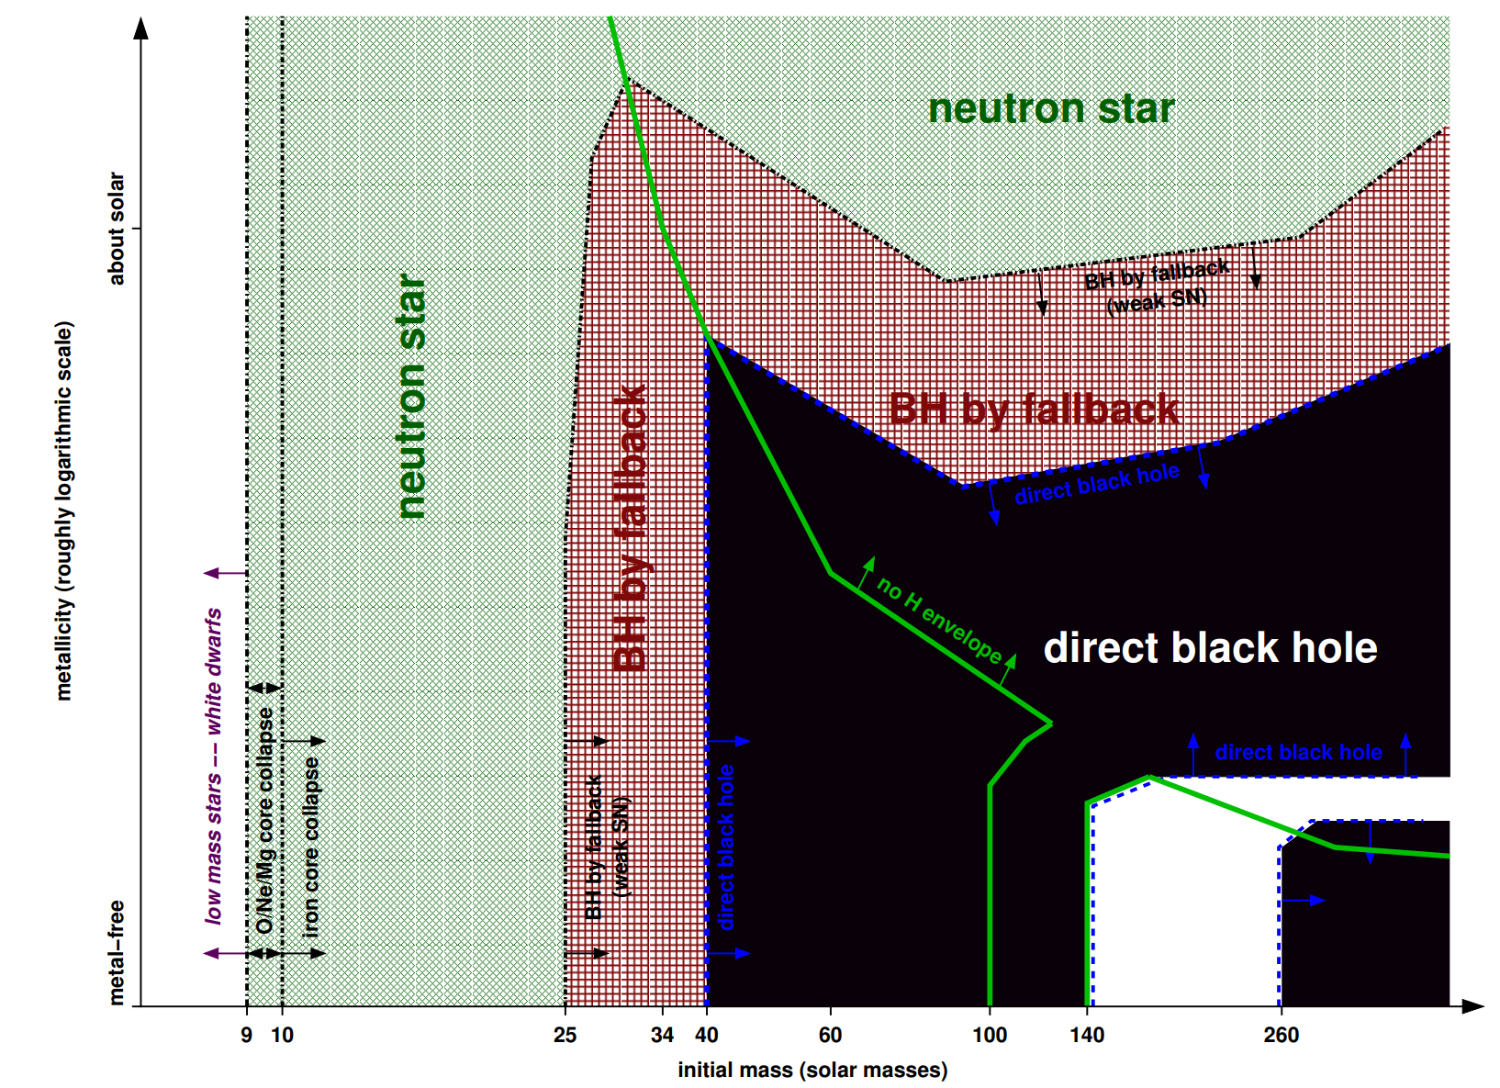
Remnants of Supernova
Credit by Heger (2003) Fig. 1.
Remnants of massive single stars as a function of initial metallicity and initial mass.
Metallicity (roughly logarithmic scale)
Initial mass (solar masses)

Slide 11
Compare Progenitor Mass and Remnants of SN
Metallicity (roughly logarithmic scale)
Metallicity (roughly logarithmic scale)
Initial mass (solar masses)
Initial mass (solar masses)
Credit by Heger (2003) Fig. 1&2.

Slide 12
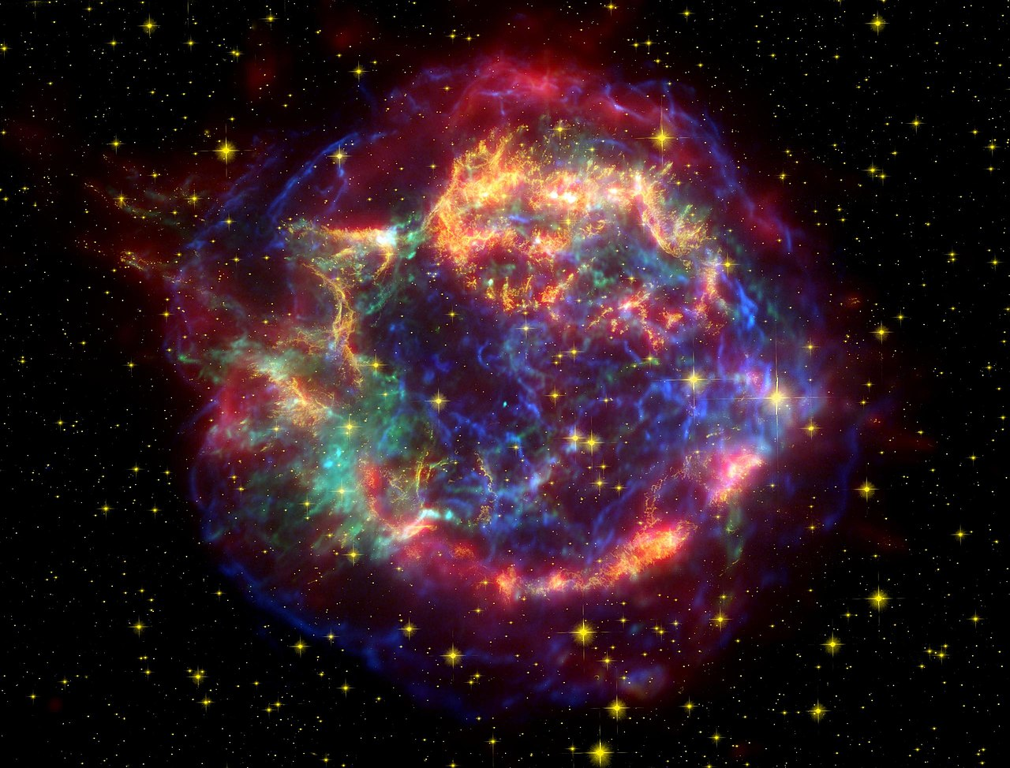
Final Profile of Type II Supernova
Property | Type II Supernovae
Progenitor Mass | ~8 – 40 M☉
Spectrum | Strong hydrogen (Hα) lines
Light Curve | Plateau (II-P), Linear decline (II-L), or Narrow emission (IIn)
Explosion Mechanism | Core collapse due to iron core instability (Chandrasekhar Limit)
Remnant | Neutron star or black hole
Energy Released | ~10⁵¹ ergs (kinetic), ~10⁵³ ergs (neutrinos)
A false color image of Cassiopeia A (Cas A) using observations from both the Hubble and Spitzer telescopes as well as the Chandra X-ray Observatory (cropped). Credit: Courtesy NASA/JPL-Caltech

Slide 13
Reference
Scioly.org. (n.d.). Astronomy/Type II Supernovae. Retrieved March 2, 2025, from https://scioly.org/wiki/index.php/Astronomy/Type_II_Supernovae
Prantzos, N. (1996). "Stellar nucleosynthesis and γ-ray line astronomy". Astronomy & Astrophysics Supplement Series. 120: 330–310(1996).
Gerry Gilmore. (2004). The Short Spectacular Life of a Superstar. Science 304,1915-1916. DOI:10.1126/science.1100370
Heger, A., Fryer, C. L., Woosley, S. E., Langer, N., & Hartmann, D. H. (2003). How massive single stars end their life. The Astrophysical Journal, 591(1), 288–300. DOI:10.1086/375341
Utrobin, V. P. (1996). Nonthermal ionization and excitation in Type IIb supernova 1993J. Astronomy and Astrophysics, v.306, p.219. abs/1996A&A...306..219U

Slide 14
THANK YOU
Spring 2025

Slide 15
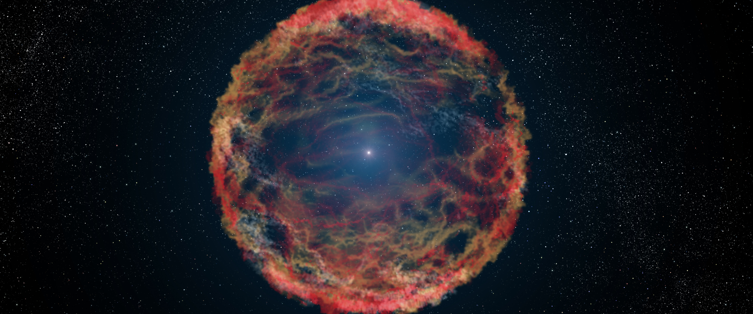
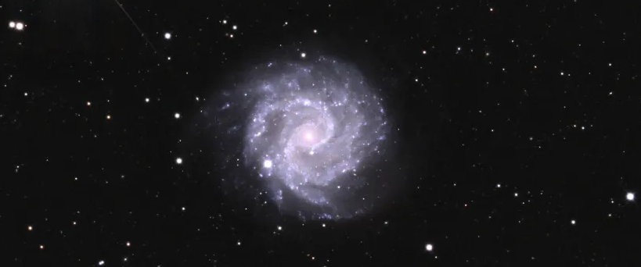
DLC (Additional Content)
Type II-b Supernova
A Type IIb supernova has a weak hydrogen line in its initial spectrum, which is why it is classified as a Type II. However, later on the H emission becomes undetectable, and there is also a second peak in the light curve that has a spectrum which more closely resembles a Type Ib supernova.
SN 1993J Credit by NASA, ESA, and G. Bacon (STScI)
Type V Supernova (Supernova imposters)
Supernova impostors are stellar explosions that appear at first to be a supernova but do not destroy their progenitor stars. As such, they are a class of extra-powerful novae.
NGC 3184 Credit by Bernese Highlands, et al.

Slide 16
Origin of the Plateau Phase
After the core collapses and the star explodes, a shock wave propagates through the outer layers, causing the ejected material to heat up and emit radiation.
Initially, the supernova is powered by the shock-deposited energy from the explosion and radioactive decay (mainly 56Ni→56Co→56Fe), making it very bright.
In Type II-P supernovae, the progenitor retains a thick hydrogen envelope before explosion.
As the ejecta expand, the hydrogen remains fully ionized (hot plasma) for an extended period.
Eventually, as the ejecta cool, hydrogen begins to recombine (protons and electrons combine to form neutral hydrogen atoms).
This recombination releases energy, maintaining a relatively stable luminosity for ~100 days → forming the plateau.
Core-burning nuclear fusion stages
for a 25-solar mass star
10
20
30
40
50
60
70
90
100
Hydrogen Burning (Helium) 10⁷ years
Rest
Triple-alpha Burning (Carbon, Oxygen) 10⁶ years
R
Carbon Burning
10³ years
Neon Burning
3 years
Oxygen Burning
0.3 years
Silicon Burning
5 days

